Slide 1
MultiCodecDASH-
SDN
Multicodec DASH Streaming over
Software Defined Networks

Slide 2
Basic of Encoding and Decoding
Transmit or Store
Decompress
(Decode)
Video Source
Compress
(Encode)
Video Display

Slide 3
CODEC
Encoder + Decoder = CODEC

Slide 4
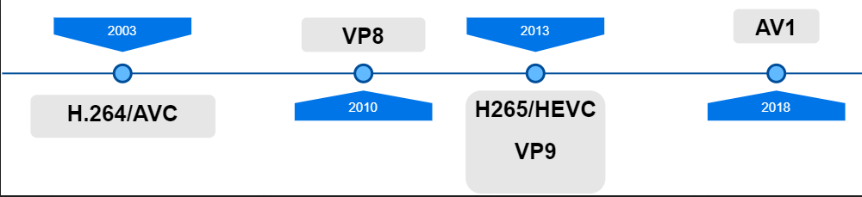
History Of Video Coders

Slide 5
Video Coding keep getting better.
MPEG-2
~ 2x better
H.264/AVC
~2x better
H.265/HEVC

Slide 6
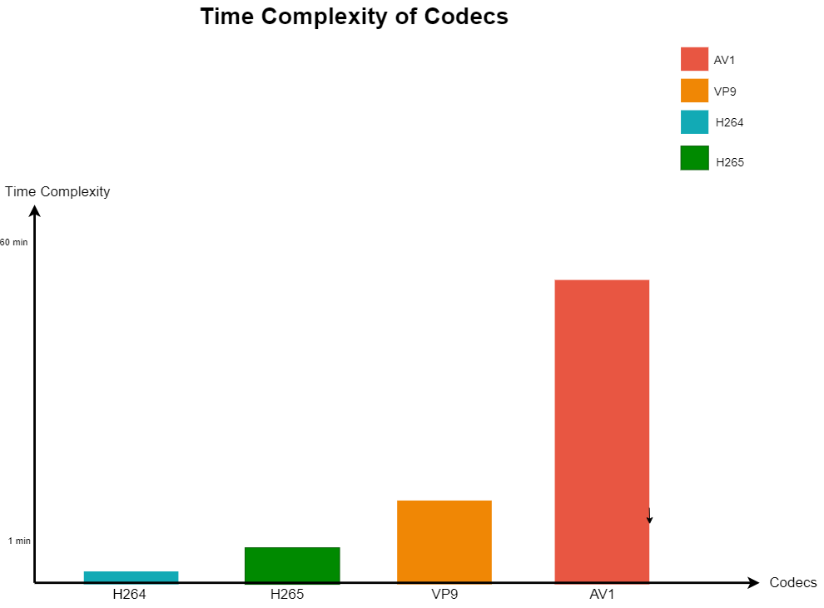
Time Complexity

Slide 7

SOFTWARE DEFINED NETWORK

Slide 8
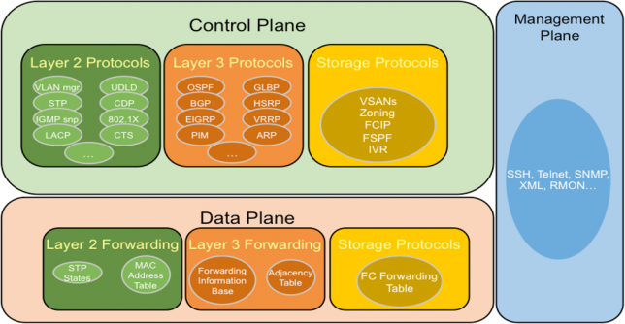
Traditional Networking

Slide 9
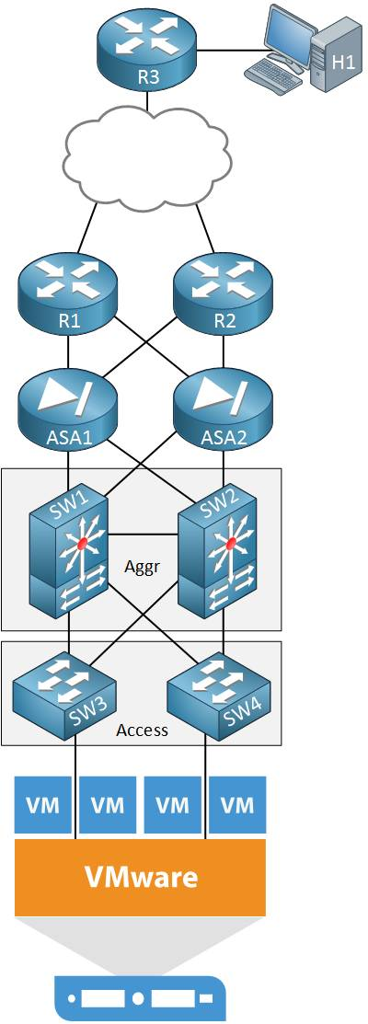
Challenges Of Traditional Networking

Slide 10
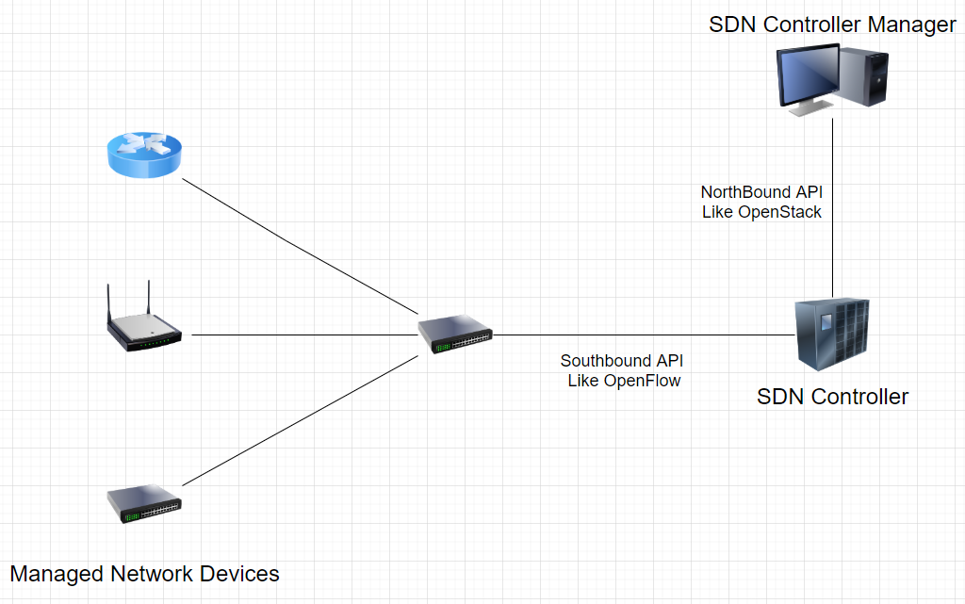
Network Controller

Slide 11
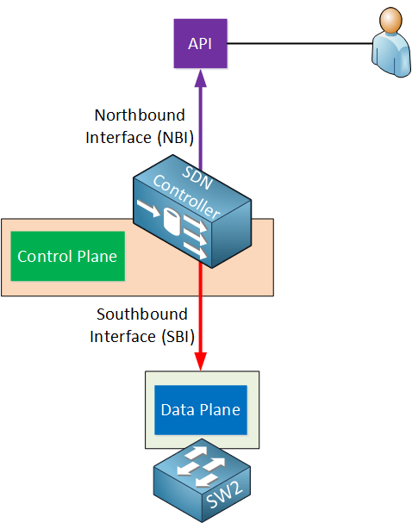
NorthBound Interface and SouthBound Interface

Slide 12
Project WorkFlow
 | Task Name
1) | Dash.js multi-codec integration
2) | Design study about software defined networks
3) | Multicodec DASH-Software Defined Networks

Slide 13
References
1-)https://www.vcodex.com/video-coding-history-part-1/, https://www.cemaltaner.com.tr/?s=SDN,

